Slide 1
8086 Pipelining
Arnab Bhattacharjee
Lecturer, Department of CSE,
United International University
Email id : arnab@cse.uiu.ac.bd
Courtesy: Nasif M. Sir,
Md. Shafqat Talukder Rakin Sir

Slide 2
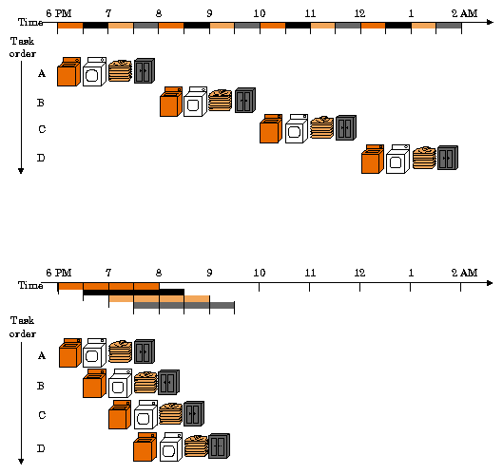

Slide 3
Trivia
For example, an x86 MOV instruction requires a two-byte opcode.
8086 instruction length is not fixed like MIPS. 8086 Instruction length depends on the instruction. It is a minimum of 1 byte and a maximum of 6 bytes long.

Slide 4
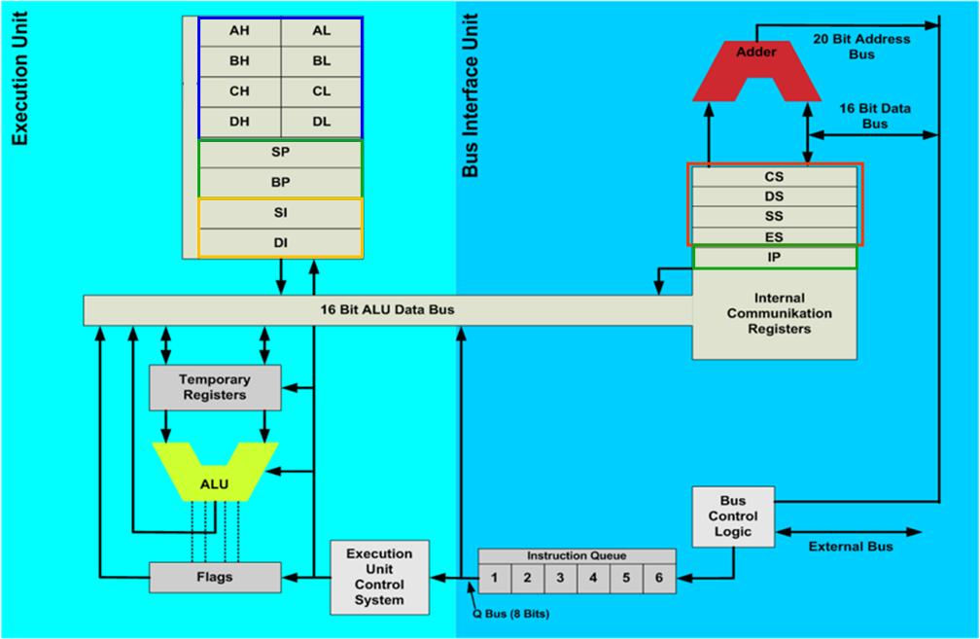
8086 Internal Architecture

Slide 5
8086 Internal Architecture
The BIU provides hardware functions, including generation of the memory and I/O addresses for the transfer of data between itself and the outside world.
The EU receives program instruction codes and data from the BIU, executes these instructions, and stores the results in the general registers. By passing the data back to the BIU, data can also be stored in a memory location or written to an output device.
The EU has no connection to the system buses. It receives and outputs all of its data through the BIU. The execution unit, or EU, handles the arithmetic and logical operations on the data and has a 6-byte first-in-first-out (FIFO) instruction queue.
The main linkage between the two functional blocks is the instruction queue, with the BIU looking ahead of the current instruction being executed in order to keep the queue filled with instructions for the EU to decode and operate on.

Slide 6
Pipelining
In 8086, to speed up the execution of program, the instructions fetching and execution of instructions are overlapped each other. This technique is known as pipelining. In pipelining, when the nth instruction is executed, the n+1th instruction is fetched and thus the processing speed is increased.
The organization of the processor into a separate BIU and EU allows the fetch and execute cycles to overlap. In the beginning, the CS:IP is loaded with the required address from which the execution is to be started.

Slide 7
The Fetch and Execute Cycle of 8086 Processor
Register IP is incremented by one to prepare for the next instruction fetch.
Once inside the BIU, the instruction is passed to the queue: a first-in/first-out storage register sometimes likened to a pipeline. Assuming that the queue is initially empty.
The EU immediately draws this instruction from the queue and begins execution.
While the EU is executing this instruction, the BIU proceeds to fetch a new instruction. Depending on the execution time of the first instruction, the BIU may fill the queue with several new instructions before the EU is ready to draw its next instruction.
The cycle continues, with the BIU filling the queue with instructions and the EU executing these instructions.

Slide 8
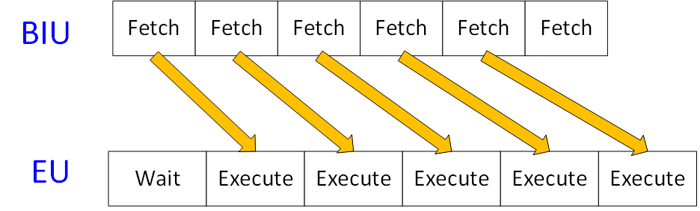
Figure: Block diagram showing Pipelining (Fetch and Execution cycle) in 8086 microprocessor

Slide 9
Instruction execution cycle
The instruction execution cycle can be clearly divided into three different steps.
Fetch
In the fetch step, an instruction is copied from the memory of the computer into the queue.
Decode
In decode step, the microprocessor figures out what actions need to be carried out in order to execute the instruction.
Execute
In execution step, the instruction is executed.

Slide 10
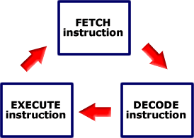
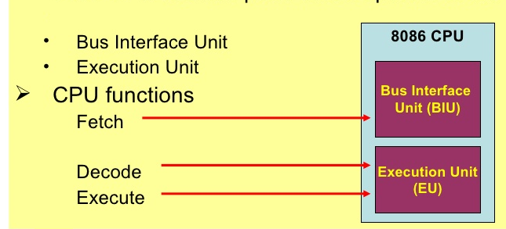

Slide 11
Conditions under which EU enter into the “Wait” state
When an instruction requires access to a memory location. The BIU must suspend fetching instructions and access the address of this memory location. After waiting for the memory access, the EU can resume executing instruction codes from the queue, and the BIU can resume filling the queue.
When the instruction to be executed is a jump instruction. In this case, control is to be transferred to a new address. The EU must wait while the instruction at the jump address is fetched. Any bytes presently in the queue must be discarded (they are overwritten).

Slide 12
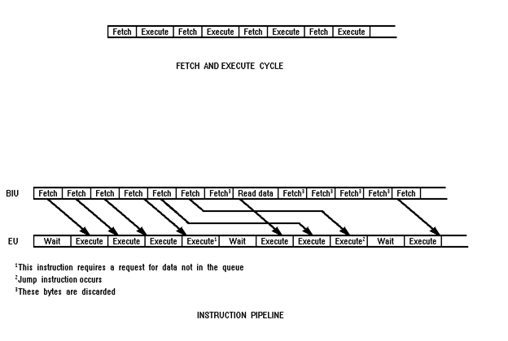
Fetch and Execute Cycle
Notes:
ADD AX, [80H]

Slide 13
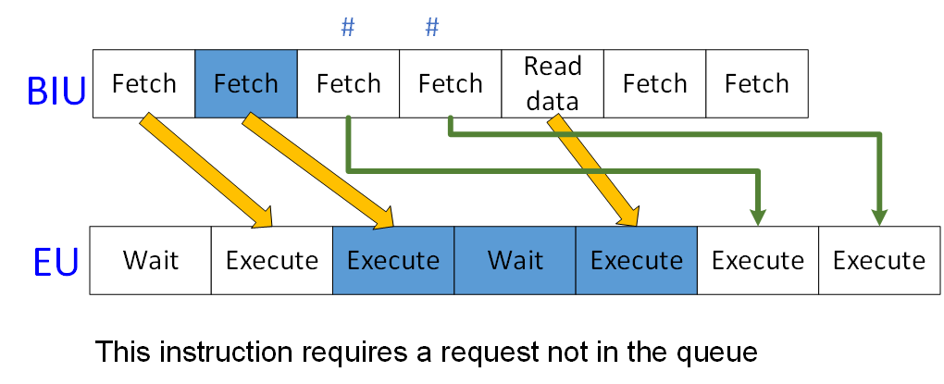

Slide 14
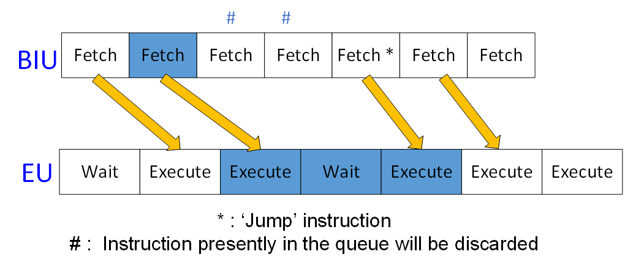

Slide 15
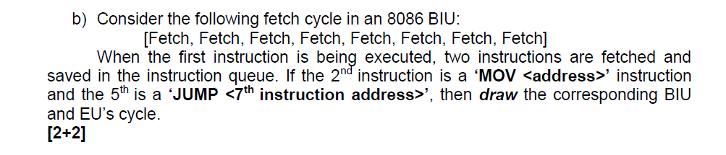

Slide 16
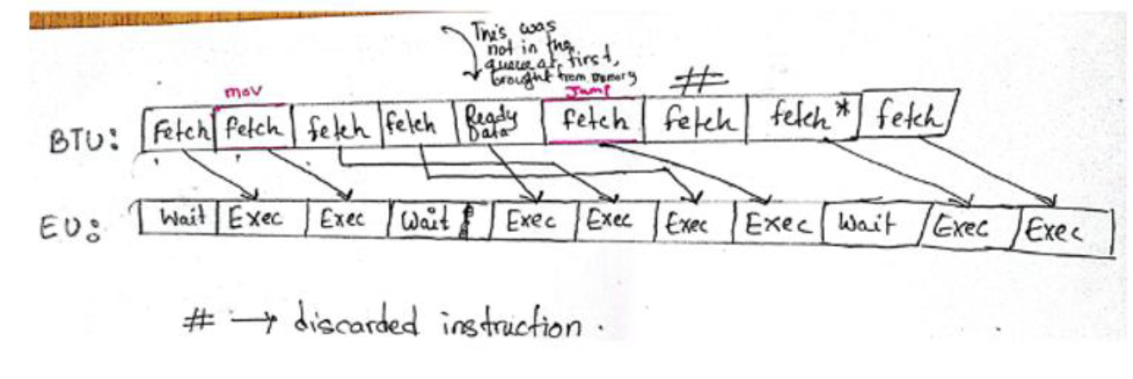

Slide 17
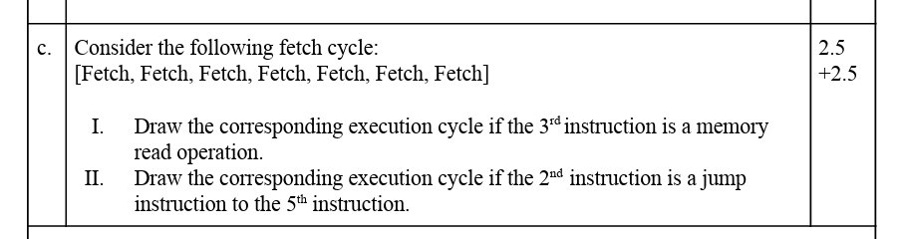

Slide 18
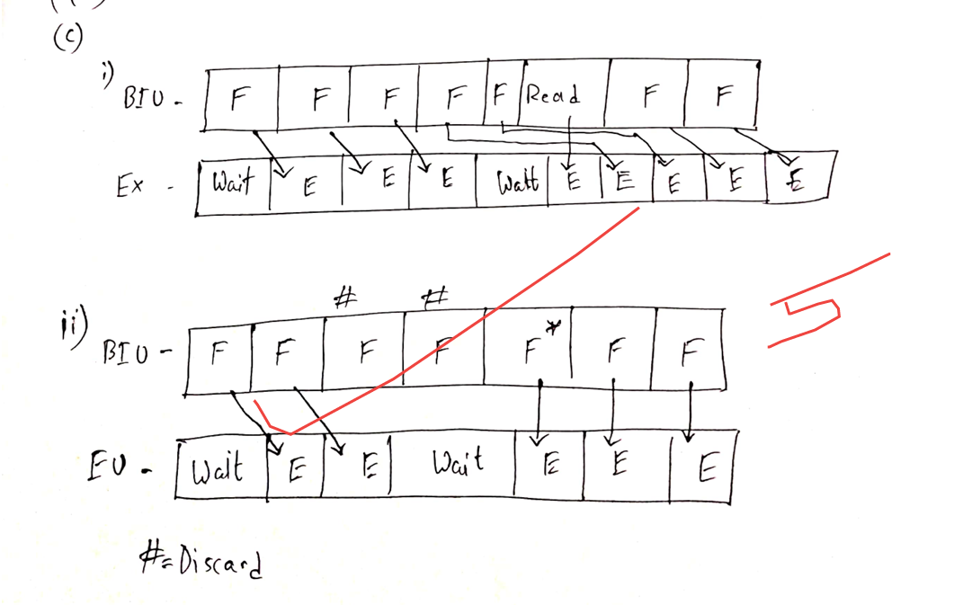

Slide 19
Thank You

